Slide 1
INTRODUCTION TO DATA SCIENCE - PROJECT
TEAM MEMBERS:
Sharanya Akkone PES2201800103
Shreya Venugopal PES2201800688
Deepali Raju PES2201800291

Slide 2
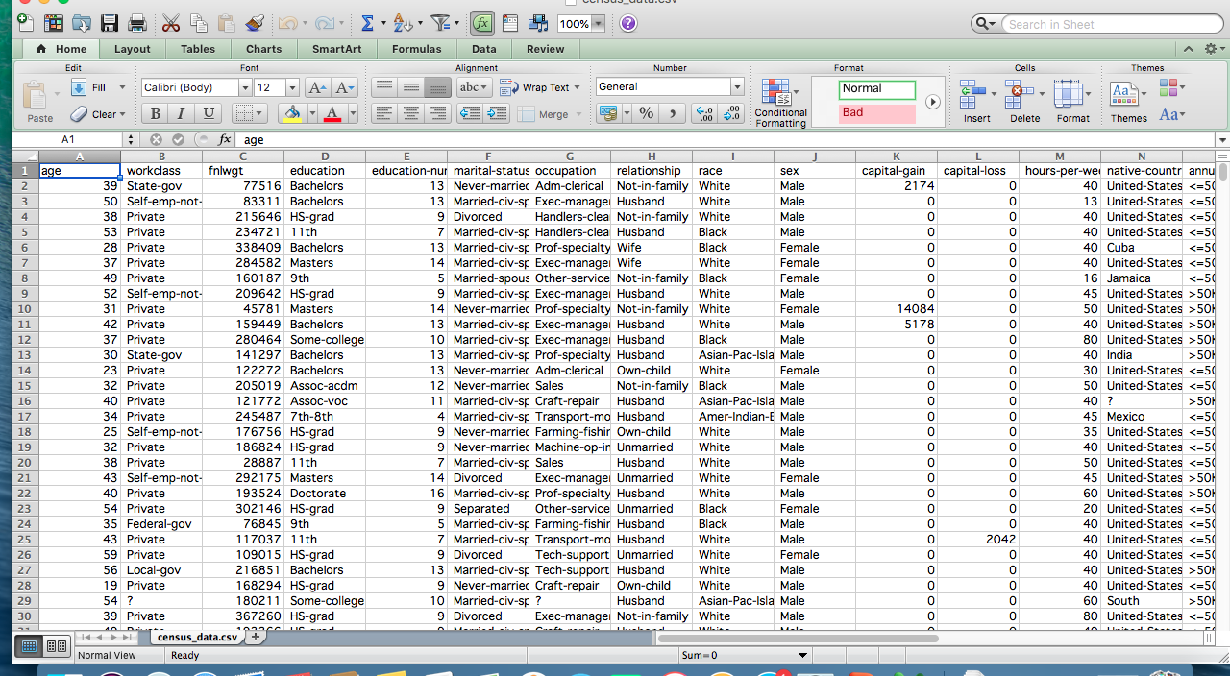
BEFORE DATA CLEANING

Slide 3
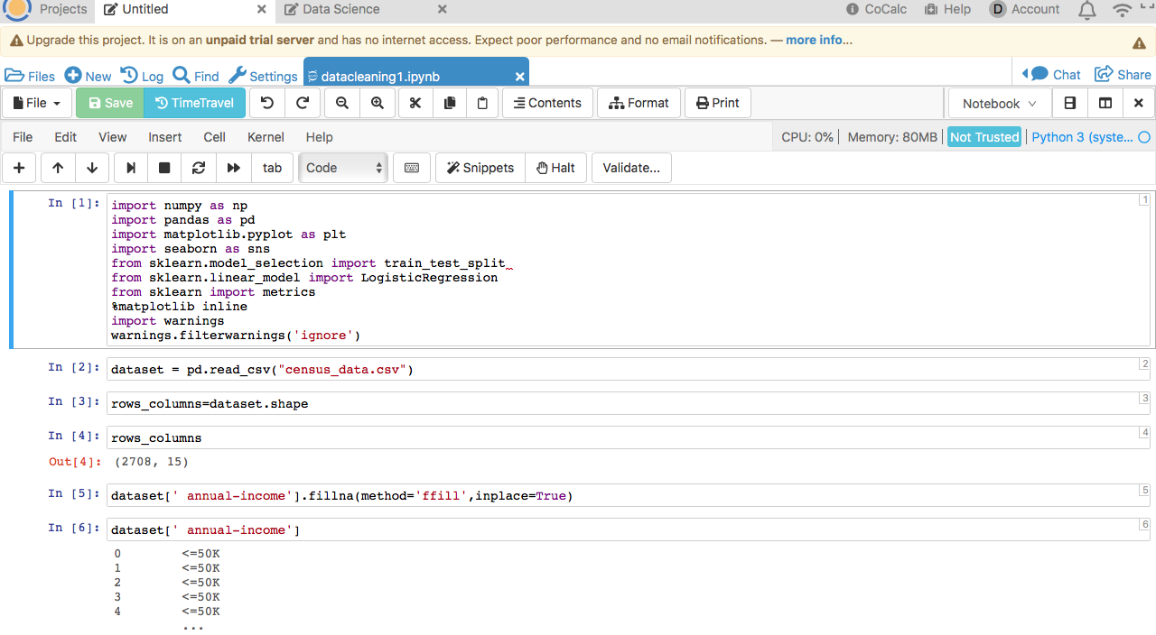
AFTER DATA CLEANING (1)

Slide 4
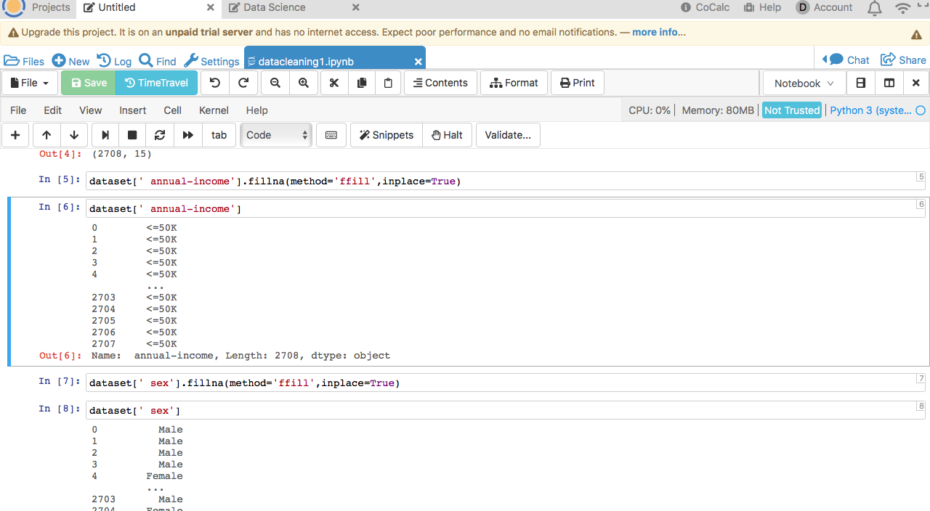
AFTER DATA CLEANING (2)

Slide 5
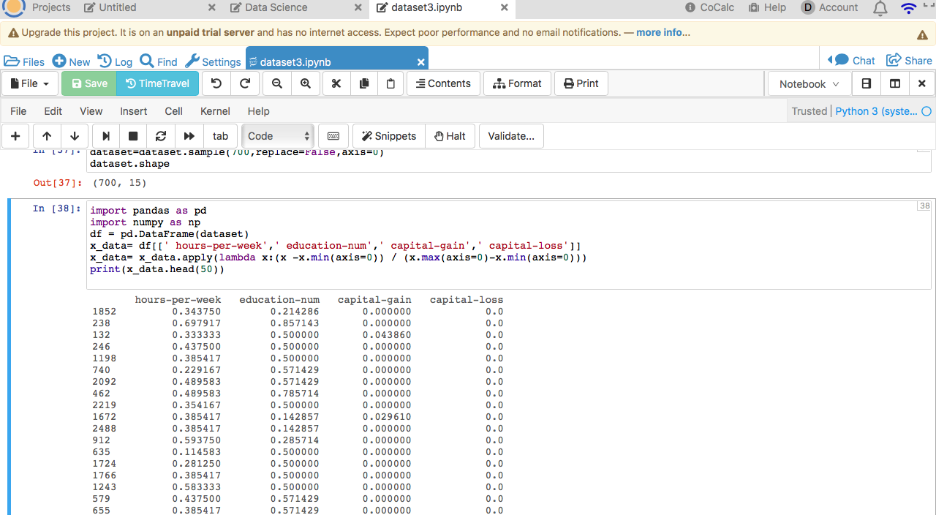
NORMALIZATION AND STANDARDISATION

Slide 6
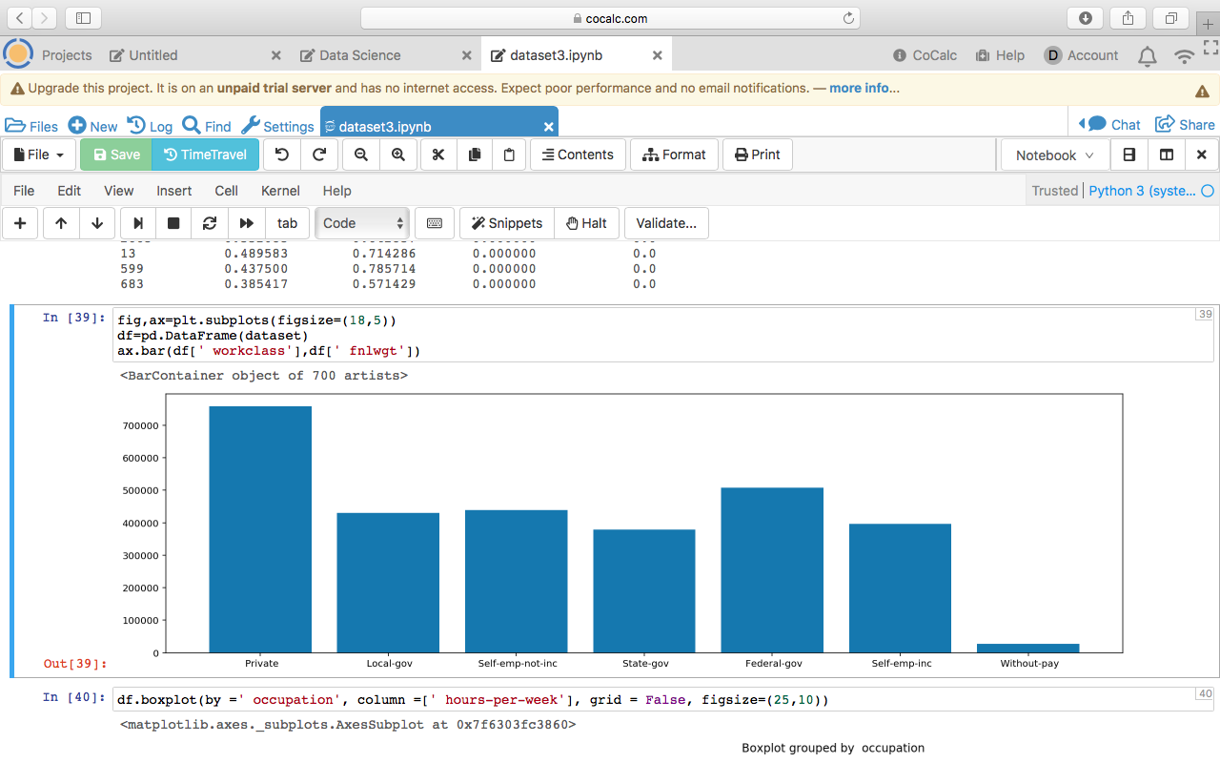
GRAPH VISUALISATION
BAR CHART
Notes:
In this bar plot we can infer that :
The people working in private companies are the most .
The people without pay or unemployment are the least.

Slide 7
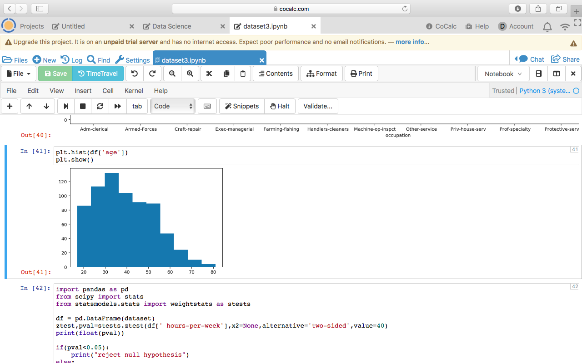
HISTOGRAM
Notes:
The people between the ages 30-40 are the highest , middle aged people are more compared to all the other age groups.
The people between the ages 75-80 are the least.

Slide 8
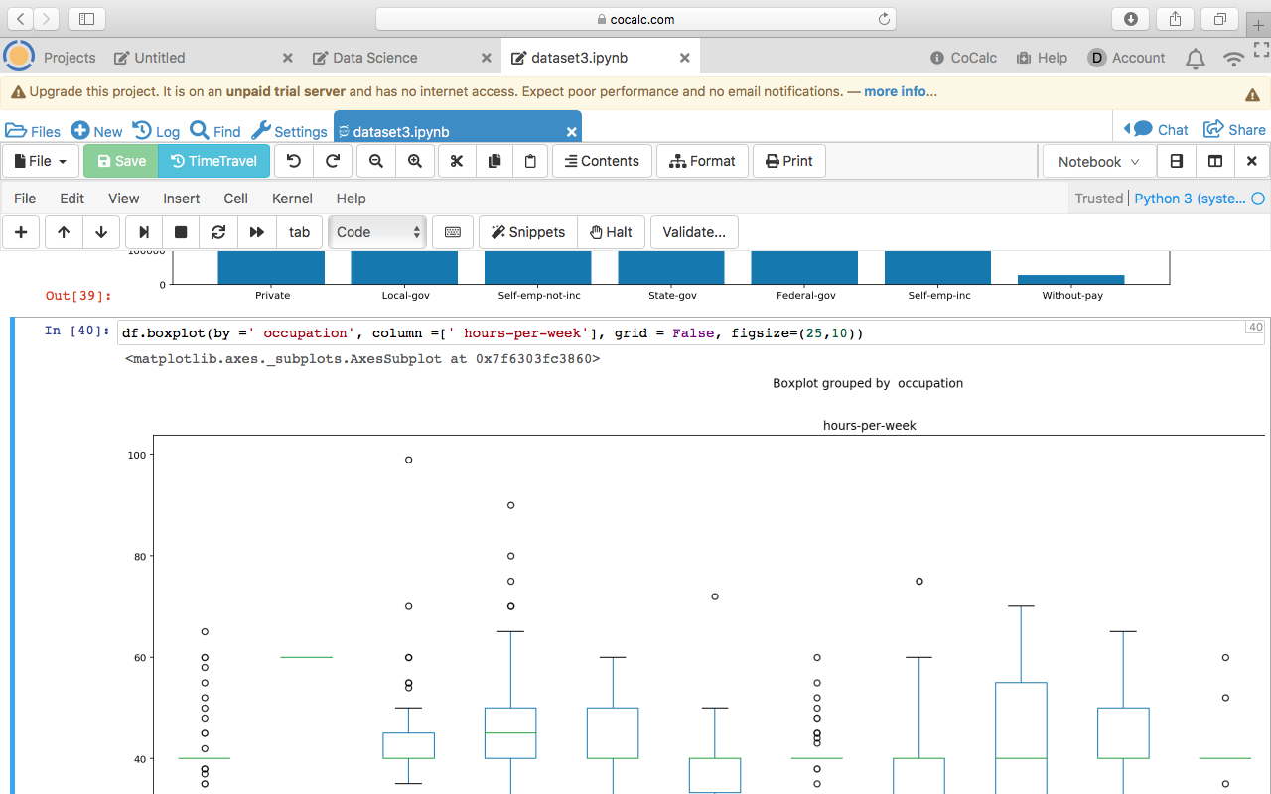
BOX PLOT

Slide 9
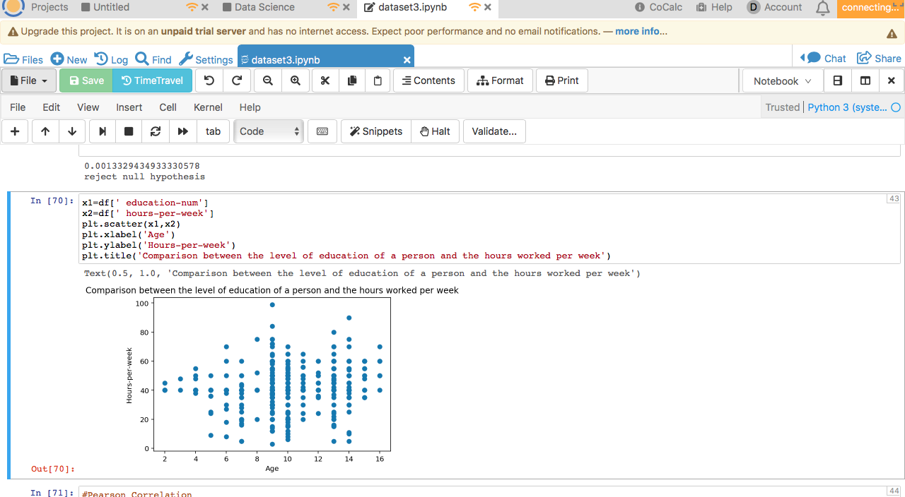
CORRELATION
Notes:
This compares the level of education of a person and the number of hours worked per week by the person.
The correlation coefficient comes only upto 0.2 which means that there is no comparison between the two variables.
The level by which they are comparable to each other is very less.

Slide 10
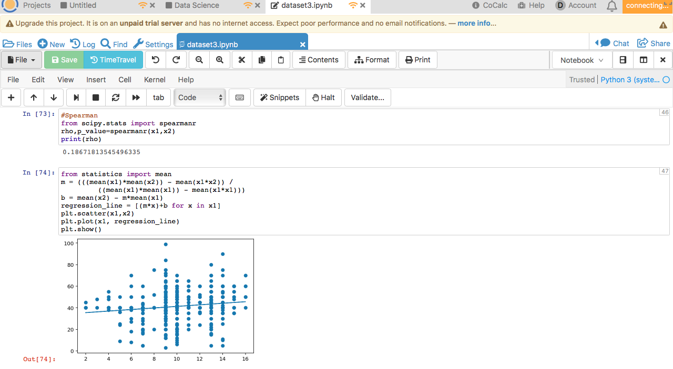
LINEAR REGRESSION
Notes:
The equation y=mx+b is the equation of the best fit line in the graph above.
y=0.92x+32
Y=(1)x+32 approximately
Y=x+32.

